Slide 1

WEB TECHNOLOGIES
K R Kundhavai
Department of Computer Science and Engineering

Slide 2

HTML, CSS and Client Side Scripting
HTML Forms
Compiled by Kundhavai K R
Department of CSE

Slide 3

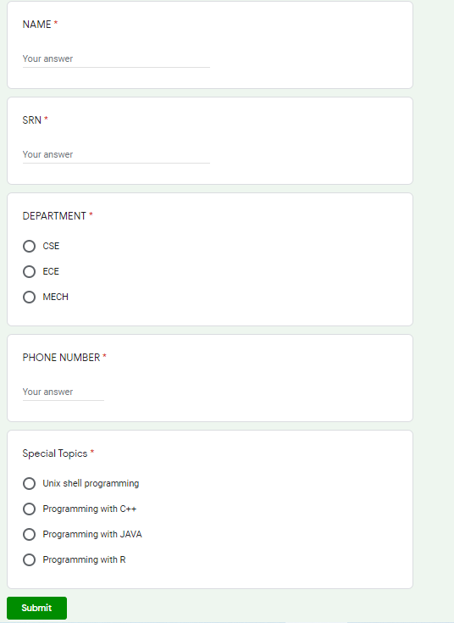

WEB TECHNOLOGIES
HTML FORMS - INTRODUCTION
What happens after I click submit button?

Slide 4
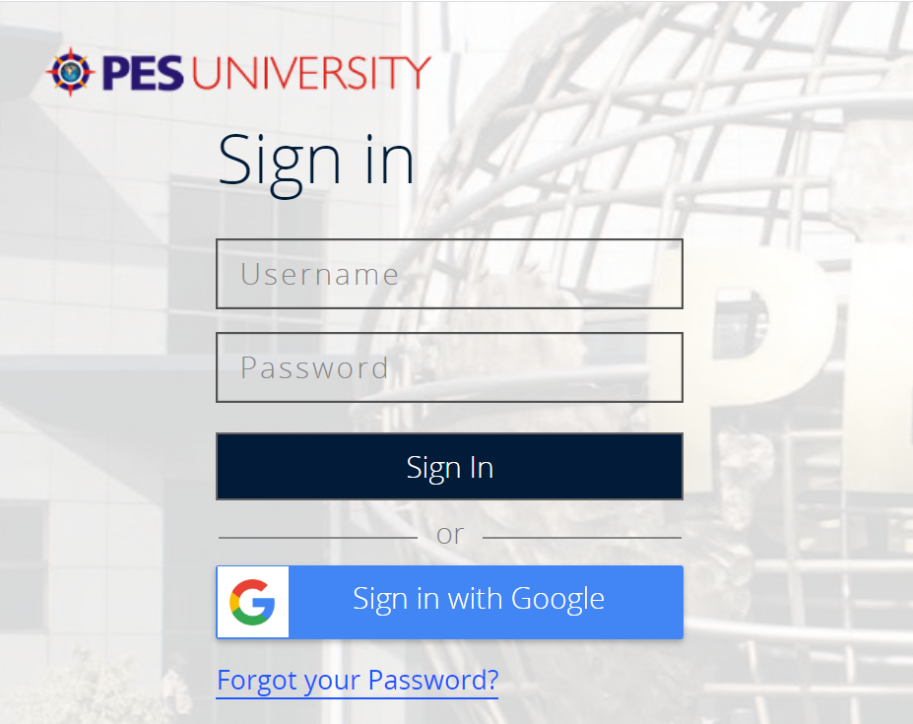
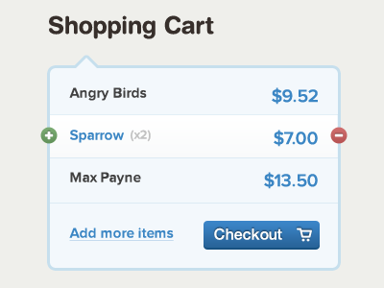
WEB TECHNOLOGIES
HTML FORMS - INTRODUCTION

Slide 5
WEB TECHNOLOGIES
HTML FORMS - INTRODUCTION
Forms provide the user with an way to interact with a web server.
Using a form, the user can enter text, choose items from lists, and click buttons.
Typically, programs running on the server will take the input from HTML forms and do something with it, such as save it in a database or interact with an external web service.
An HTML form contains form elements.
Syntax:
<form>
Form elements
</form>
Notes:
The <form> element is a container for different types of input elements, such as: text fields, checkboxes, radio buttons, submit buttons, etc.

Slide 6
WEB TECHNOLOGIES
FORM TAG - ATTRIBUTES
The Action Attribute - defines the action to be performed when the form is submitted.
Usually, the form data is sent to a file on the server when the user clicks on the submit button.
Eg: <form action=“update.php”>
If the action attribute is omitted, the action is set to the current page.
The Target Attribute - specifies if the submitted result will open in a new browser tab, a frame, or in the current window.
The default value is "_self" which means the form will be submitted in the current window.
To make the form result open in a new browser tab, use the value "_blank": Other legal values are "_parent", "_top”.
Notes:
In the example above, the form data is sent to a file called “update.php". This file contains a server-side script that handles the form data:

Slide 7
WEB TECHNOLOGIES
FORM TAG - ATTRIBUTES
The Method Attribute - specifies the HTTP method (GET or POST) to be used when submitting the form data.
The default method when submitting form data is GET.
However, when GET is used, the submitted form data will be visible in the page address field.
<form action=“update.php” target=“_blank” method=“POST”>
Form elements
</form>

Slide 8
WEB TECHNOLOGIES
HOW FORMS WORK

Slide 9
WEB TECHNOLOGIES
FORM Elements
The HTML <form> element can contain one or more of the following form elements:
<input>
<label>
<select>
<textarea>
<button>
<fieldset>
<legend>
<datalist>
<output>
<option>
<optgroup>

Slide 10
WEB TECHNOLOGIES
FORM Elements

Slide 11
WEB TECHNOLOGIES
FORM Elements - <select> Tag
HTML <select> tag is used to create drop down list of options.
The <option> tag is used to define the possible options to choose from. The tag is put into the <select> tag.
The first option from the list of options is selected by default. Otherwise use the selected attribute.
The <optgroup> tag is used to group several options into one group. The content of <optgroup> looks like heading in bold.
Examples:

Slide 12
WEB TECHNOLOGIES
FORM Elements
The <textarea> element defines a multi-line input field (a text area).
The rows attribute specifies the visible number of lines in a text area.
The cols attribute specifies the visible width of a text area.

Slide 13
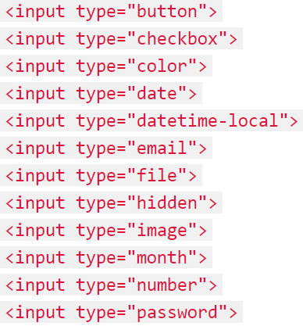
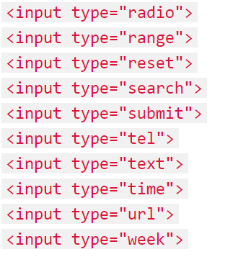
WEB TECHNOLOGIES
FORM Elements - HTML Input Types

Slide 14
WEB TECHNOLOGIES
Test and Run at your end
<input type=“month”>
<input type=“week”>
<input type="datetime" >
<input type="datetime-local“>
<input type="url“>
<input type=“search“>

Slide 15
THANK YOU
Kundhavai K R
Department of CSE
kundhavai@pes.edu

